Slide 1
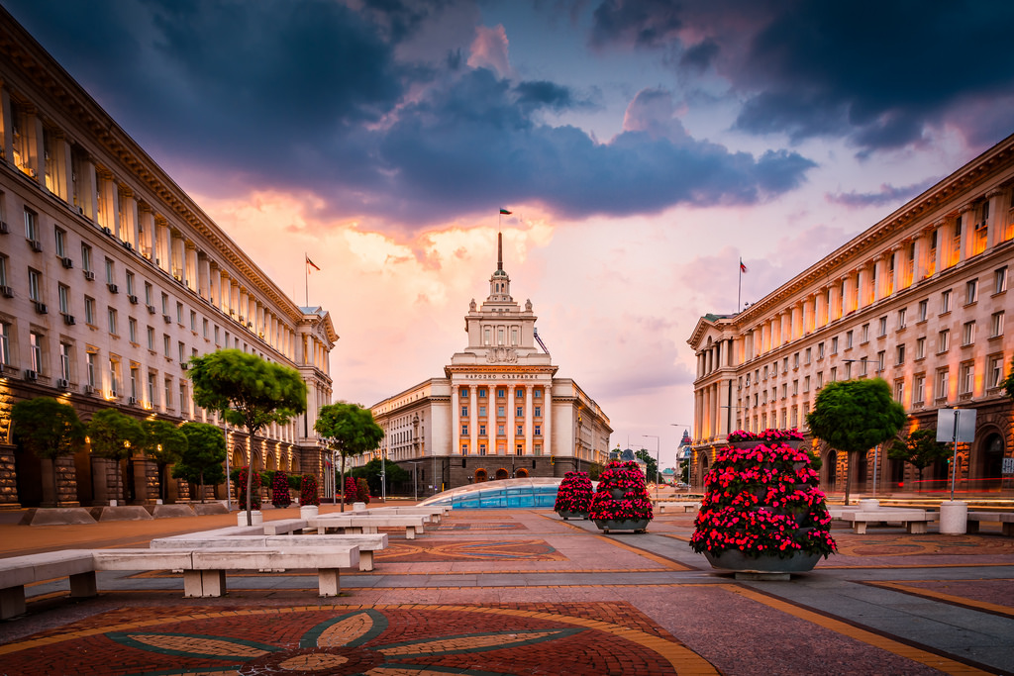



Viktor Velev, Vladislav Georgiev, Kaloyan Madjunov
Martin Datsev, Petar Milev, Telerik Arsov

Slide 2


THE PROBLEM
The difficult tourists orientation in Sofia
The difficulty of finding a place to live

Slide 3

THE Solution
Fast user friendly analysis of Sofia
Population density
Sport facilities
Best quarters to live in

Slide 4

The Technologies
NLTK
NumPy
Selenium
GenSim

Slide 5

The Analysis
Data assimilate
Airbnb API
Tripadvisor API
Dataset with a polyon of the quarters in Sofia

Slide 6
Time for demo

Slide 7


Summary
The Problem
The Solution
The Technologies
The Analysis

